Slide 1
Gender Identification
A project on Probability-Based Machine Learning System

Slide 2
Table of Contents
Objective
System Overview
Data Input
Learning System
Prediction System
Incremental Storage & Feedback
Expected Outcome
Future Enhancements
Conclusion

Slide 3
Objective
Purpose: Develop a system that can predict gender based on name input and improve over time with user feedback.
Train Initial Model: Utilize a dataset of names with gender labels and probabilities to create a predictive model.
Enable Incremental Learning: Allow the system to learn from user feedback, improving accuracy over time.
Interactive User Experience: Facilitate user input for name predictions and capture corrections for continuous improvement.

Slide 4
System Overview
Data Input: Loads a dataset containing names, gender labels, and confidence probabilities.
Function: Provides the foundational data for training the model.
Learning System: Trains a machine learning model using the loaded dataset.
Function: Identifies patterns in names and associates them with gender, enabling accurate predictions.
Prediction System: Accepts user input (names) to predict gender.
Function: Checks if the name is already learned; if not, uses the trained model for predictions.
Incremental Storage & Feedback: Stores new user-provided names and corrections.
Function: Enhances the model by integrating user feedback for continuous learning and improvement.

Slide 5
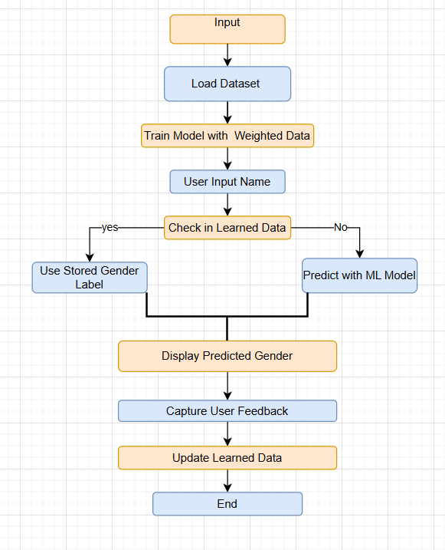
Flow-chart

Slide 6
Data Input
Dataset Source: The system utilizes a CSV file containing a list of names along with their corresponding gender labels and probability scores.
Structure: The CSV file must include the following columns:
Name: The name to be analyzed.
Gender: The associated gender (e.g., male, female).
Probability: A confidence score indicating the reliability of the gender label.
Loading Process: The system reads the CSV file to load the dataset, which serves as the foundation for training the machine learning model.

Slide 7
Learning System
Model Training: The system uses a logistic regression model, trained on a dataset of names, genders, and probabilities to identify patterns and make predictions.
Incremental Learning: As users provide feedback on predictions, the system updates its knowledge base, allowing it to learn from corrections and improve accuracy over time.
User-Driven Updates: Each new name and its associated gender, provided by the user, are stored for future training, enhancing the model’s performance with diverse data.

Slide 8
Prediction System
User Input: The system prompts users to enter a name for gender prediction.
It first checks if the name exists in the learned data.
If found, it retrieves the stored gender.
If the name is not found, the system uses the trained machine learning model to predict the gender based on the input name.
Display Results:
The predicted gender is displayed to the user, who can then confirm its accuracy.
Feedback Loop:
Users have the option to provide corrections, which are saved to improve future predictions.

Slide 9
Incremental Storage & Feedback
Purpose of Incremental Storage:
Store new names and genders based on user feedback.
Improves model predictions over time without full retraining.
Persistent Learning:
Learnings are saved to a file (pickle format) and loaded each time the system start.
Discuss the potential to periodically retrain on both initial and learned data.

Slide 10
Expected Outcome
A functional machine learning system that accurately predicts gender based on names.
Improved model accuracy over time through user feedback and incremental learning.
An interactive user interface that allows easy input of names and immediate feedback on predictions.
Enhanced adaptability to diverse naming conventions and cultural variations.
A stored repository of learned names that continuously enriches the model’s knowledge base.

Slide 11
Future Enhancements
Expanded Dataset: Integrate a larger and more diverse dataset to improve model accuracy across different cultures and languages.
User-Friendly GUI: Develop a graphical user interface (GUI) to enhance user experience and make interactions more intuitive.
Advanced Algorithms: Explore and implement more sophisticated machine learning algorithms, such as deep learning models, for better predictions.
Feedback Analytics: Introduce analytics to track user feedback trends and identify common corrections, helping to refine the model further.
Multi-Language Support: Enable support for multiple languages to broaden the system's applicability globally.

Slide 12
Conclusion
The Probability-Based Machine Learning System effectively predicts gender based on names.
It utilizes an initial dataset for model training and incorporates user feedback for continuous improvement.
The system's incremental learning feature enhances accuracy over time, making it adaptable to diverse naming conventions.
This user-friendly interface allows for straightforward name input, prediction, and correction, ultimately refining the model.
The system has practical applications in personalized marketing, data analysis, and demographic studies.

